Slide 2
What’s New In ‘ Visual Studio 64-bit IDE, C++20, WSL2, and More
Marian Luparu (he/him) @mluparu
Sy Brand (they/them) @TartanLlama
C++ Product Team, Microsoft
@VisualC
https://aka.ms/cpp

Slide 3
Welcome to CppCon 2021!
Join #visual_studio channel on CppCon Discord https://aka.ms/cppcon/discord
Meet the Microsoft C++ team
Ask any questions
Discuss the latest announcements
Take our survey https://aka.ms/cppcon

Slide 4
🚀 Mission of the C++ product team at Microsoft
Empower every C++ developer and their teams to achieve more
by participating in the creation of the C++ Standards
by investing in the Microsoft Visual C++ (MSVC) Compiler & Libraries
by simplifying acquisition in C++ via vcpkg
by improving the Visual Studio IDE
by continuing to enhance the C++ experience for Visual Studio Code
Our agenda today

Slide 5
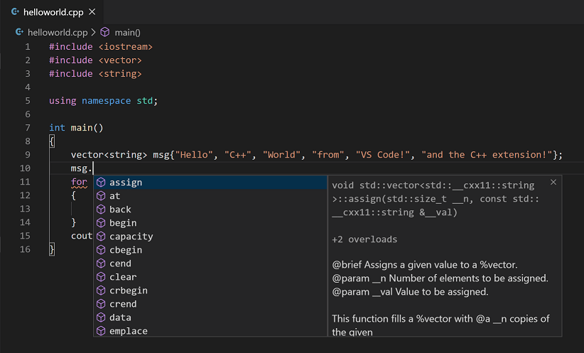
Visual Studio Code Session coming up!
Thu 10/28 – 2pm
An Editor Can Do That? Debugging Assembly Language and GPU Kernels in Visual Studio Code
Julia Reid – _3
#1 most used code editor
[StackOverflow Developer Surveys]
Free, open-source code editor
Runs on Windows, macOS, and Linux
C++ IntelliSense, debug & code browsing
CMake, vcpkg and git integrations
SSH/container/WSL remote experiences
and much much more…
https://aka.ms/cpp/code

Slide 6
Visual Studio
CppCon 2020

Slide 7
Visual Studio 2019
Version 16.8
Preview 1
Preview 2
Version 16.9
Preview 1
Preview 2
Preview 3
Version 16.10
Preview 1
Preview 2
Preview 3
Version 16.11
Preview 3
Preview 4
Preview 3
Preview 4
Preview 5
Preview 4
Preview 5
Preview 6
CppCon 2020
Sep
2020
Nov
2020
Mar
2021
May
2021
Aug
2021

Slide 8
Visual Studio 2022
You’re invited
Launch Event
📅 Monday, November 8th, 2021
⏰ 8:30 AM PT
https://aka.ms/vs2022launch
Preview 1
Preview 2
Preview 3
Preview 4
Release Candidate
Visual Studio 2022
May
2021
Nov
2021
Oct
2021
(today)
CppCon 2021

Slide 9
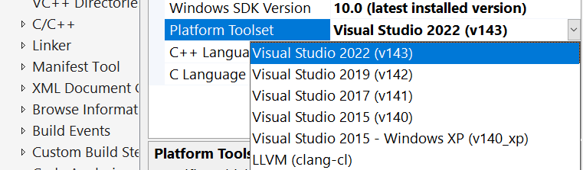
Pain-Free Upgrade to Visual Studio 2022
Step #1: Install Visual Studio 2022
💡 Visual Studio 2022 installs side-by-side with older Visual Studio versions (e.g. 2019, 2017)
Step #2: Compile your code (with the same compiler as today)
💡 MSVC 2015, 2017 and 2019 toolsets are available directly from Visual Studio 2022
Step #3: Compile your code with the latest compiler
💡 Binary compatibility between the VS2022 and previous C++ runtimes (VS 2019, VS 2017, VS 2015)
Step #4: Compile your dependencies with the latest compiler
💡 Have peace of mind upgrading all your open-source libraries with vcpkg (https://vcpkg.io)
Next: Upgrade to future minor releases of the MSVC toolset at your own pace
💡 Side-by-side minor Visual Studio 2022 toolsets (14.30, 14.31, etc.)
Porting and Upgrading Guide: https://aka.ms/cpp/upgrade

Slide 10
Visual Studio
Agenda
Conformance
Code Safety
Cross-platform development
Developer and Team Productivity

Slide 11
Visual Studio
Agenda
Conformance
Code Safety
Cross-platform development
Developer and Team Productivity

Slide 12
At CppCon last year

Slide 13
Announcing
In Visual Studio 2019 version 16.11,
C++20 is now
feature complete
All features under /std:c++20 switch are production ready including modules, coroutines, concepts
C++20 features awaiting DR resolution are available for now under /std:c++latest
Visit https://aka.ms/cpp/20 for more details

Slide 14
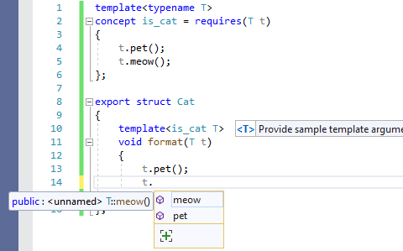
C++20 in Visual Studio
☑️ MSVC
☑️ MSVC Code Analysis
☑️ MSBuild
;⌛ CMake
;⌛ GCC
;⌛ Clang/LLVM
Code Navigation ☑️
Linters ☑️
Colorization & Formatting ☑️
IntelliSense ⌛;
Edit
Build
Debug
Developer inner-loop
☑️ Stepping
☑️ Parallel Stacks
☑️ Debugger visualizers (.natvis)
☑️ Just My Code debugging

Slide 15
Demo

Slide 16
C++20 in action
Thu, Oct 28 – 10:30am
C++20’s <chrono> Calendars and Time Zones in MSVC
Miya Natsuhara – `Online _4
Tue, Oct 26 – 10:30am
Documentation in The Era of Concepts and Ranges
Sy Brand, Christopher Di Bella – `Online _3
Mon, Oct 25 – 3:15pm
Implementing C++ Modules: Lessons Learned, Lessons Abandoned
Cameron DaCamara, Gabriel Dos Reis – _2
Thu, Oct 28 – 3:15pm
Why does std::format do that?
Charlie – _1
Tue, Oct 26 – 4:45pm / Wed, Oct 27 – 12:30pm
In-memory and Persistent Representations of C++
Gabriel Dos Reis – `Online _2

Slide 17
Visual Studio
✅ C++98*
* with /permissive-
✅ C++11
✅ C++14
✅ C++17
✅ C++20*
*awaiting DR resolution
🐱‍🏍 C++23
with /std:c++latest
🏁 Feature complete
C++23
out_ptr and inout_ptr
contains for basic_string and basic_string_view
Other small features
🕙 Coming next for C++23
STL
Standard library modules
Coroutines

Slide 18
Visual Studio
Agenda
Conformance
Code Safety
Cross-platform development
Developer and Team Productivity

Slide 19
Static Analysis
✴ New and improved checkers in MSVC Code Analysis
Returning a local variable with std::move
Path-sensitive bounds checking
Use-after-move
Lifetime checking for coroutines
Thu, Oct 28 – 4:45pm / Fri, Oct 29 – 12:00pm
Finding bugs using path-sensitive static analysis
Gabor Horvath – _3
Tue, Oct 26 – 3:15pm
Static Analysis and Program Safety in C++: Making it Real
Sunny Chatterjee – _2

Slide 20
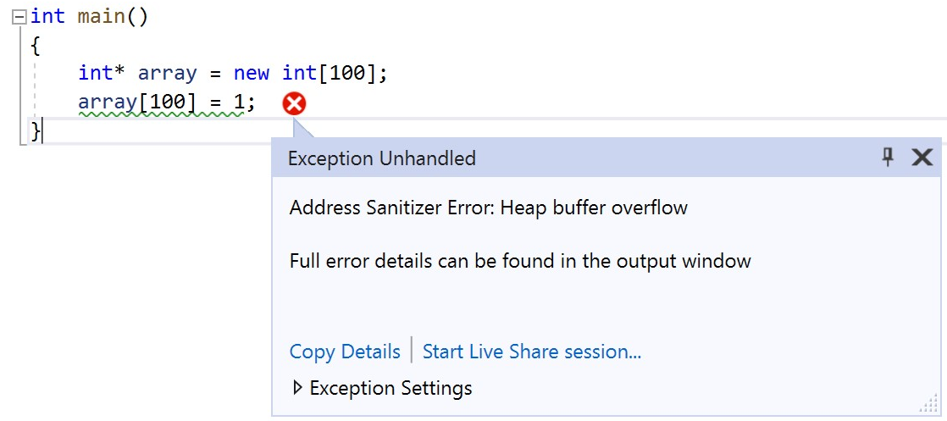
Address Sanitizer
/fsanitize=address support in MSVC now generally-available
x86 and X64 support
Debug configurations (/MTd, /MDd) included
Runtime libraries automatically linked for command-line builds
Visual Studio integration
MSBuild & CMake support for Windows & Linux
Debugger integration for MSVC and Clang/LLVM
Visit https://aka.ms/asan to learn more

Slide 21
Announcing today
Experimental libFuzzer Support
An in-process, coverage-guided, evolutionary fuzzing engine
Available in Visual Studio 2022
Under /fsanitize=fuzzer
Visit https://aka.ms/cpp/libfuzzer for more details

Slide 22
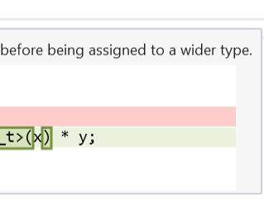
Code Analysis in Visual Studio
🗿 Static Analysis
⚡ Dynamic Analysis
Code Linters https://aka.ms/cpp/linter
Clang-tidy https://aka.ms/cpp/clangtidy
MSVC Code Analysis https://aka.ms/cpp/ca/bg
Address Sanitizer https://aka.ms/asan
Fuzzing with libFuzzer https://aka.ms/cpp/libfuzzer

Slide 23
Visual Studio
Agenda
Conformance
Code Safety
Cross-platform development
Developer and Team Productivity

Slide 24
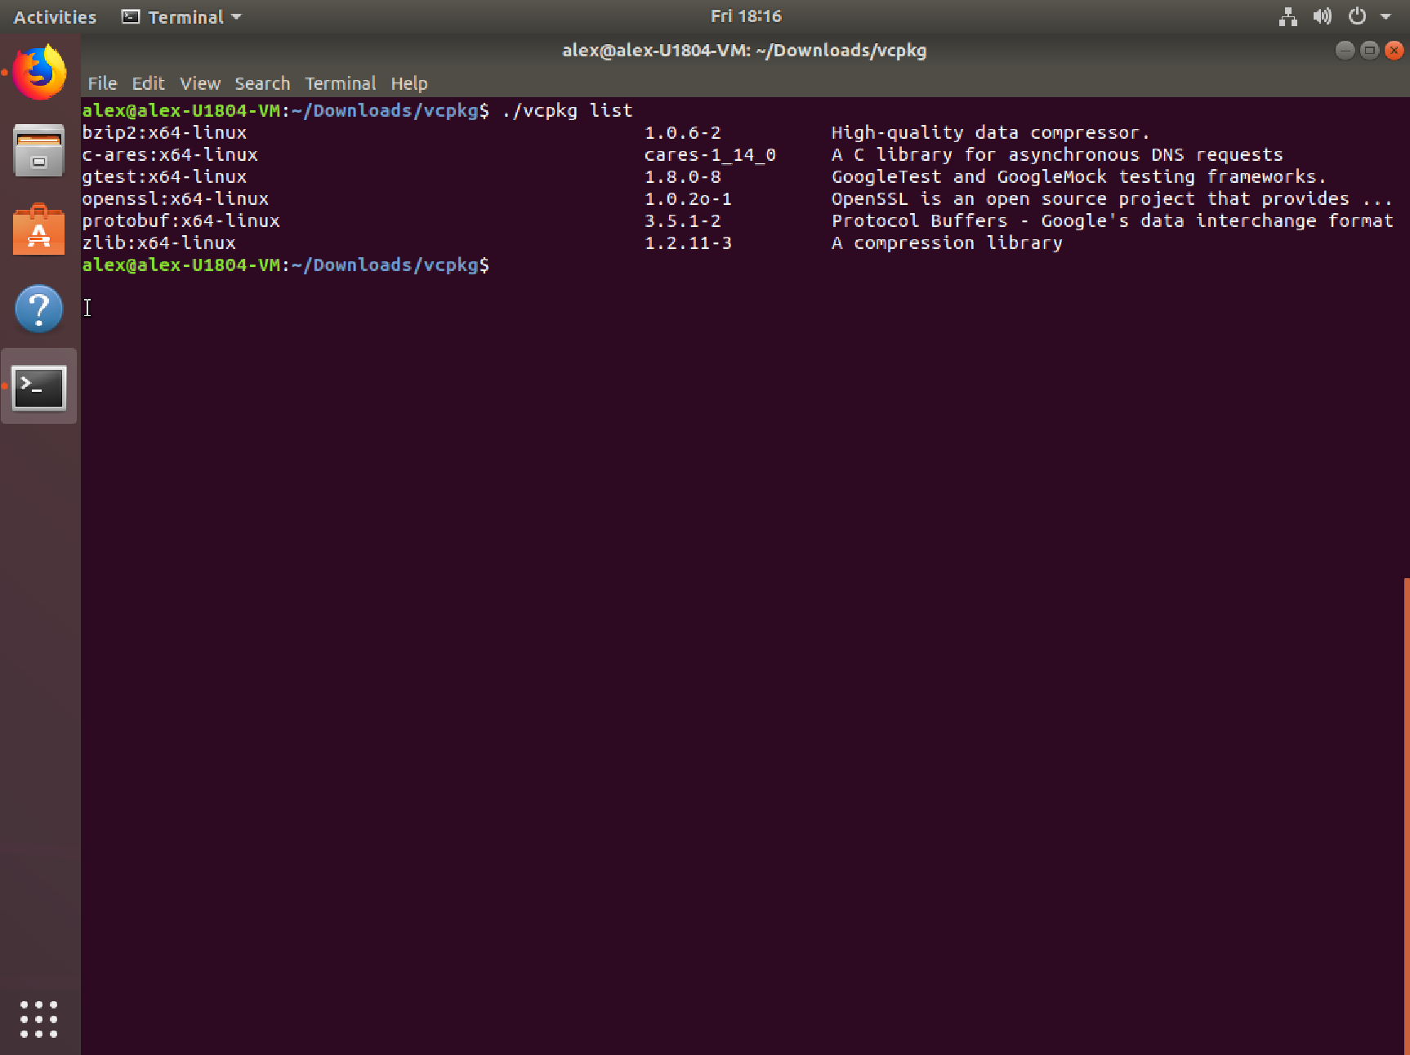
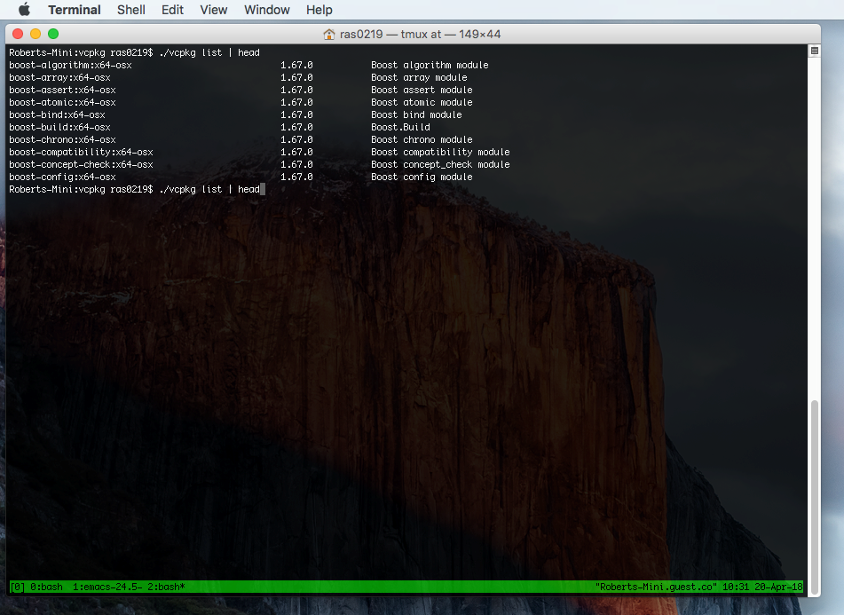
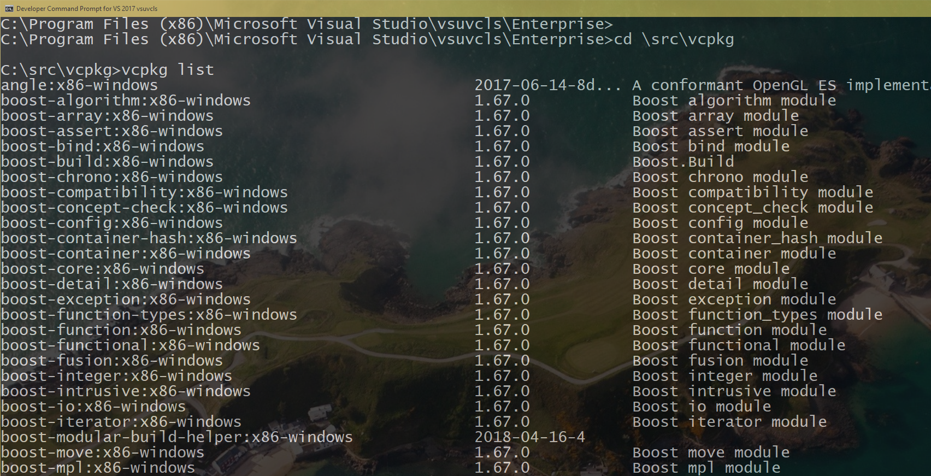
Simplify C++ dependency management with . vcpkg
Open-source library manager for Windows, Linux, and macOS
1700+ popular open-source libraries available for installation
Built from source, on-demand
Centralized, tested catalog (no version conflicts)
Popular build targets supported by default, and you can add your own custom targets
🔎 https://vcpkg.io

Slide 25
vcpkg is Enterprise Ready
📚 Registries Create your own private library catalog for use within vcpkg; great for internal, closed-source 3rd party libraries and community repositories | 🔢 Versioning Choose which library versions you want (works both in the command line and manifest).
📝 Manifest Express your dependencies declaratively. | 📦 Binary Caching Share the compiled libraries you consume locally with your development team and continuous integration system
Visit https://aka.ms/vcpkg/team for more details

Slide 26
Demo

Slide 27
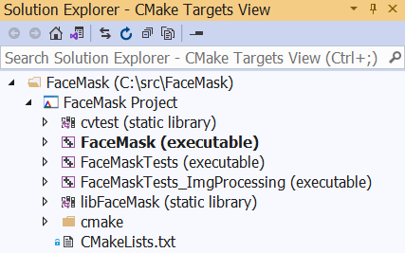
CMake integration
CMake is a first-class project system in Visual Studio
Familiar edit-build-debug inner-loop
including MSVC and Clang-tidy squiggles & quick actions
Doxygen integration
Target Windows, Linux, macOS, MinGW and more
Seamless onramp to CI with CMakePresets.json
Learn more at https://aka.ms/cmake

Slide 28
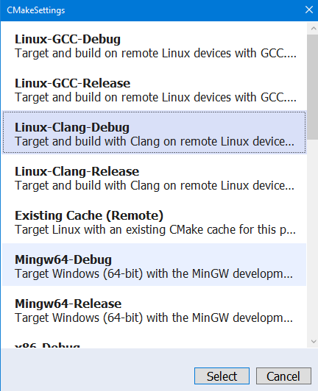
🐧 Linux targeting
Target any Linux distro, including WSL (Windows subsystem for Linux) and WSLg (Linux GUI on Windows 11)
C++ IntelliSense can parse remote Linux headers in GCC mode
Build remotely via MSBuild or CMake
Debug local or remote targets, with GDB or LLDB
Learn more at https://aka.ms/vslinux

Slide 29
Learn more at https://aka.ms/vslinux/blizzard

Slide 30
Visual Studio
Agenda
Conformance
Code Safety
Cross-platform development
Developer and Team Productivity

Slide 31
New in Visual Studio 2022
64bit IDE
New themes available https://aka.ms/vsthemes
Or bring your own VSCode theme to VS
Color-coded tabs
Git integration
Multi-repo support
Publish code to GitHub or Azure Devops
Pinning branches & customizations
Hot Reload
Dependent breakpoints & Force run to cursor
And… performance

Slide 32
Performance of Visual Studio
Edit
Build
Debug
Developer inner-loop

Slide 33
Performance of Visual Studio
Find in Files
1.8x faster
Edit
Build
Debug
Open C++ File
2.4x faster
IntelliSense Ready*
1.9x faster
*) Colorization + Member List
Developer inner-loop
Open Member List
29% faster
Unreal Engine 4.27.1
IntelliSense Ready
18x faster
Learn more at http://aka.ms/18xfaster

Slide 34
Performance of Visual Studio
Find in Files
1.8x faster
Edit
Build
Debug
Open C++ File
2.4x faster
IntelliSense Ready*
1.9x faster
*) Colorization + Member List
Developer inner-loop
Open Member List
29% faster
Unreal Engine 4.27.1
IntelliSense Ready
18x faster
Learn more at http://aka.ms/18xfaster

Slide 35
At CppCon last year

Slide 36
Performance of Visual Studio
Find in Files
1.8x faster
Link time
28x faster
5x faster
18x faster
Edit
Build
Debug
Open C++ File
2.4x faster
IntelliSense Ready*
1.9x faster
*) Colorization + Member List
Developer inner-loop
Open Member List
29% faster
Unreal Engine 4.27.1
IntelliSense Ready
18x faster
Learn more at http://aka.ms/18xfaster

Slide 37
Performance of Visual Studio
Find in Files
1.8x faster
Link time
28x faster
5x faster
18x faster
Edit
Build
Debug
Open C++ File
2.4x faster
IntelliSense Ready*
1.9x faster
*) Colorization + Member List
Developer inner-loop
Open Member List
29% faster
Unreal Engine 4.27.1
IntelliSense Ready
18x faster
Learn more at http://aka.ms/18xfaster
Runtime Performance for Debug Builds
2x-3x faster

Slide 38
Developer Community
🏆 Top suggestion tickets implemented
C++ IntelliSense Support for C++20 Concepts and Ranges libraries
Build a subset of CMake targets with CMakePresets.json
Leverage IntelliSense in CMake projects targeting Android or embedded
Improve IntelliSense tooltip for make_shared/make_unique/emplace_back/etc
Implement the equivalent of Wmissing-braces
Update the bundled Android NDK to Release r21 LTS and track the LTS releases of the NDK
Share your feedback at https://aka.ms/cpp/suggest

Slide 39
🚀 Mission of the C++ product team at Microsoft
Empower every C++ developer and their teams to achieve more
by participating in the creation of the C++ Standards
by investing in the Microsoft Visual C++ (MSVC) Compiler & Libraries
by simplifying acquisition in C++ via vcpkg
by improving the Visual Studio IDE
by continuing to enhance the C++ experience for Visual Studio Code

Slide 40
Happy Coding!
Thank you

Slide 41
Enjoy the rest of the conference!
Join #visual_studio channel on CppCon Discord https://aka.ms/cppcon/discord
Meet the Microsoft C++ team
Ask any questions
Discuss the latest announcements
Take our survey https://aka.ms/cppcon

Slide 42
Our Sessions
Monday 25th
Implementing C++ Modules: Lessons Learned, Lessons Abandoned – Cameron DaCamara & Gabriel Dos Reis
Tuesday 26th
Documentation in The Era of Concepts and Ranges – Sy Brand & Christopher Di Bella (Google)
Static Analysis and Program Safety in C++: Making it Real – Sunny Chatterjee
In-memory and Persistent Representations of C++ – Gabriel Dos Reis (online 27th)
Wednesday 27th
What's New in Visual Studio: 64-bit IDE, C++20, WSL 2, and more – Sy Brand & Marian Luparu
Thursday 28th
C++20’s <chrono> Calendars and Time Zones in MSVC – Miya Natsuhara
An Editor Can Do That? Debugging Assembly Language and GPU Kernels in Visual Studio Code – Julia Reid
Why does std::format do that? – Charlie Barto
Finding bugs using path-sensitive static analysis – Gabor Horvath (online 29th)

